Slide 1
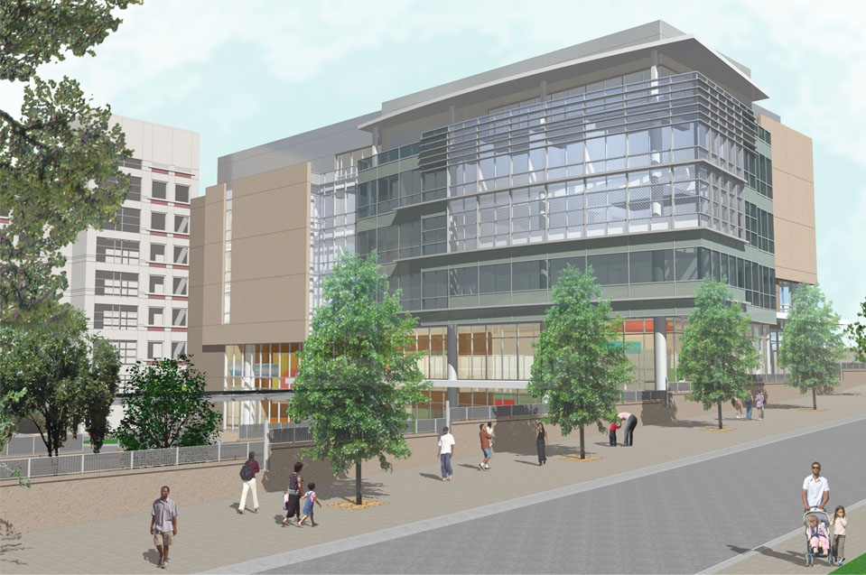
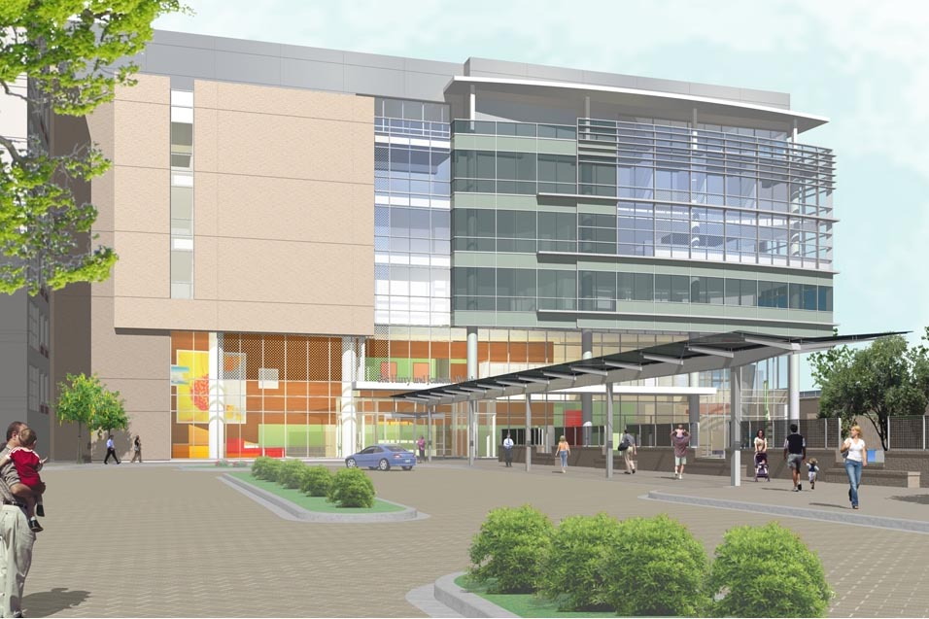
Kennedy Krieger Institute
Outpatient Medical Center
Baltimore, Maryland
Katie Sennett
Construction Management
Dr. Messner
Spring 2008

Slide 2

Kennedy Krieger Institute
Outpatient Medical Center
Baltimore, Maryland
Katie Sennett
Construction Management
Improving Cost, Constructability, & Quality
Project Overview
Analysis 1: Structural System
Analysis 2: Mechanical System
Analysis 3: 3D Design Coordination
Acknowledgements
Questions/Comments

Slide 3
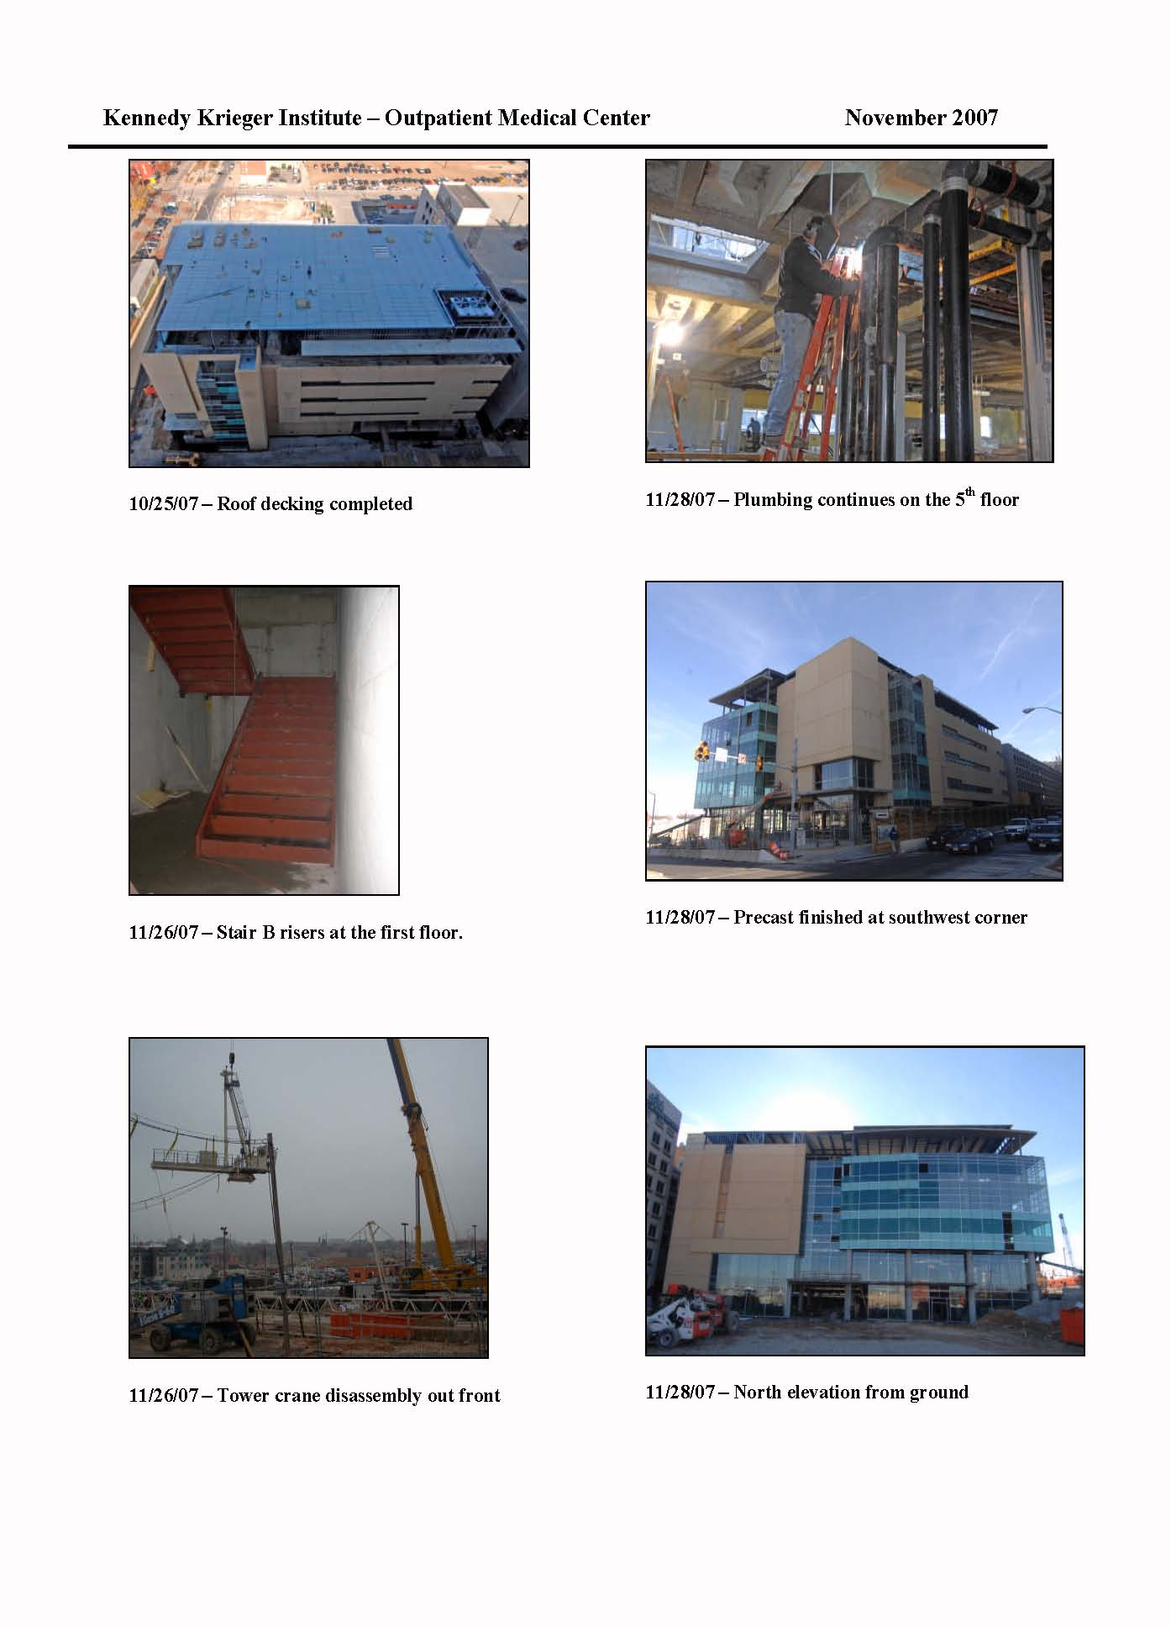
Kennedy Krieger Institute
Outpatient Medical Center
Baltimore, Maryland
Katie Sennett
Construction Management
Project Overview
Location: Baltimore Maryland
Occupancy and Function: Outpatient Medical Center for the Developmental Disabilities of Children
Size: 115,000 Square Feet
Schedule: 24 Months – Starting Jan. 2007 & Ending Jan. 2009
Total Project Cost: $3.5 Million
Project Delivery Method: CM @ Risk
Improving Cost, Constructability, & Quality
Project Overview
Analysis 1: Structural System
Analysis 2: Mechanical System
Analysis 3: 3D Design Coordination
Acknowledgements
Questions/Comments

Slide 4
Kennedy Krieger Institute
Outpatient Medical Center
Baltimore, Maryland
Katie Sennett
Construction Management
Project Overview
Location: Baltimore Maryland
Occupancy and Function: Outpatient Medical Center for the Developmental Disabilities of Children
Size: 115,000 Square Feet
Schedule: 24 Months – Starting Jan. 2007 & Ending Jan. 2009
Total Project Cost: $3.5 Million
Project Delivery Method: CM @ Risk
Project Team
Owner: Kennedy Krieger Institute
CM: Whiting- Turner Contracting Company
Architect: Stanley, Beaman, and Sears
Structural & MEP Engineer: RFM Engineering
Civil Engineer: RK +K
Improving Cost, Constructability, & Quality
Project Overview
Analysis 1: Structural System
Analysis 2: Mechanical System
Analysis 3: 3D Design Coordination
Acknowledgements
Questions/Comments

Slide 5
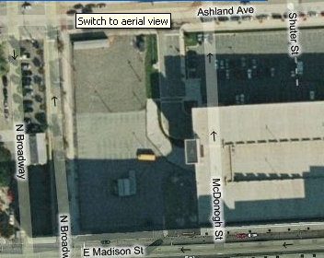
Kennedy Krieger Institute
Outpatient Medical Center
Baltimore, Maryland
Katie Sennett
Construction Management
Project Overview
Existing Site Condition: A parking lot
Improving Cost, Constructability, & Quality
Project Overview
Analysis 1: Structural System
Analysis 2: Mechanical System
Analysis 3: 3D Design Coordination
Acknowledgements
Questions/Comments
KKI Parking Garage
Foundation : Mat Slab Foundation System

Slide 6
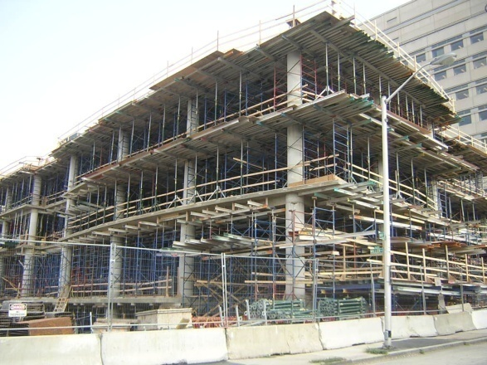
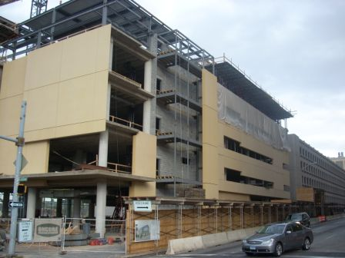
Kennedy Krieger Institute
Outpatient Medical Center
Baltimore, Maryland
Katie Sennett
Construction Management
Project Overview
Existing Site Condition: A parking lot
Structure: Cast In Place Concrete
Improving Cost, Constructability, & Quality
Project Overview
Analysis 1: Structural System
Analysis 2: Mechanical System
Analysis 3: 3D Design Coordination
Acknowledgements
Questions/Comments
KKI Parking Garage
Building Envelope: Precast Architectural Panels
Foundation : Mat Slab Foundation System

Slide 7
Kennedy Krieger Institute
Outpatient Medical Center
Baltimore, Maryland
Katie Sennett
Construction Management
Analysis 1
Changing Structural System
Problem: Structural System was timely and required employees to work weekends for 2 months. It was also had a high price.
Objective: To change structural system from Cast –In-Place Concrete to Structural Steel to reduce construction schedule and project cost.
Improving Cost, Constructability, & Quality
Project Overview
Analysis 1: Structural System
Analysis 2: Mechanical System
Analysis 3: 3D Design Coordination
Acknowledgements
Questions/Comments

Slide 8
Kennedy Krieger Institute
Outpatient Medical Center
Baltimore, Maryland
Katie Sennett
Construction Management
Analysis 1
Changing Structural System
Problem: Structural System was timely and required employees to work weekends for 2 months. It was also had a high price.
Objective: To change structural system from Cast –In-Place Concrete to Structural Steel to reduce construction schedule and project cost.
Procedure
  Redesign structural system
  Determine NEW construction schedule
  Create Sequence schedule
  Cost comparison to original system
Improving Cost, Constructability, & Quality
Project Overview
Analysis 1: Structural System
Analysis 2: Mechanical System
Analysis 3: 3D Design Coordination
Acknowledgements
Questions/Comments

Slide 9
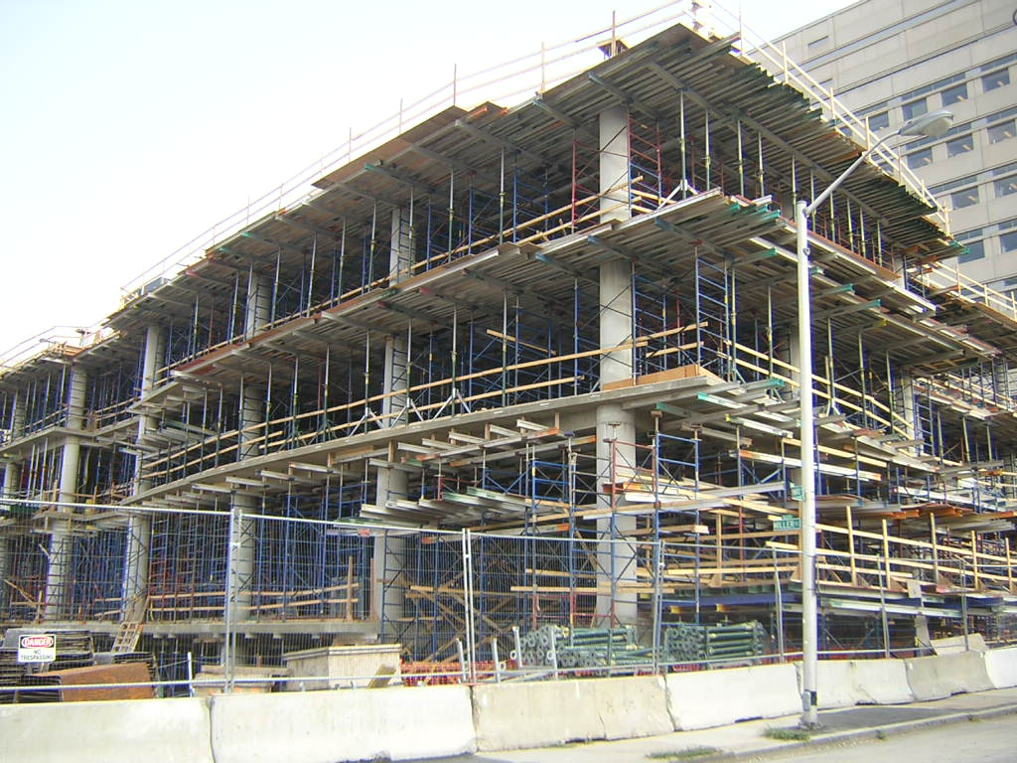
Kennedy Krieger Institute
Outpatient Medical Center
Baltimore, Maryland
Katie Sennett
Construction Management
Analysis 1
Changing Structural System
Problem: Structural System was timely and required employees to work weekends for 2 months. It was also had a high price.
Objective: To change structural system from Cast –In-Place Concrete to Structural Steel to reduce construction schedule and project cost.
Procedure
  Redesign structural system
  Determine NEW construction schedule
  Create Sequence schedule
  Cost comparison to original system
Improving Cost, Constructability, & Quality
Project Overview
Analysis 1: Structural System
Analysis 2: Mechanical System
Analysis 3: 3D Design Coordination
Acknowledgements
Questions/Comments
Initial Building: Typical Bay Size 29’ x 29’
Pan and Joist Flooring System
(Orientation North-South)
Columns Size: 30” diameter

Slide 10
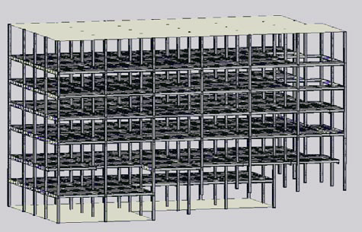
Kennedy Krieger Institute
Outpatient Medical Center
Baltimore, Maryland
Katie Sennett
Construction Management
Analysis 1
Changing Structural System
Problem: Structural System was timely and required employees to work weekends for 2 months. It was also had a high price.
Objective: To change structural system from Cast –In-Place Concrete to Structural Steel to reduce construction schedule and project cost.
Procedure
  Redesign structural system
  Determine NEW construction schedule
  Create Sequence schedule
  Cost comparison to original system
Improving Cost, Constructability, & Quality
Project Overview
Analysis 1: Structural System
Analysis 2: Mechanical System
Analysis 3: 3D Design Coordination
Acknowledgements
Questions/Comments
Typical Bay size: 29’ x 29’
Total Building Live Load: 246.5 kips
Total Building Dead Load: 378.1 kips
Beam Size: 16 x 26
Girder Size: 21 x 68
Column Size: 14 x 90
(Orientation of beams East-West)

Slide 11
Kennedy Krieger Institute
Outpatient Medical Center
Baltimore, Maryland
Katie Sennett
Construction Management
Analysis 1
NEW Schedule
Changing Structural System
Problem: Structural System was timely and required employees to work weekends for 2 months. It was also had a high price.
Objective: To change structural system from Cast –In-Place Concrete to Structural Steel to reduce construction schedule and project cost.
Procedure
  Redesign structural system
  Determine NEW construction schedule
  Create Sequence schedule
  Cost comparison to original system
Improving Cost, Constructability, & Quality
Project Overview
Analysis 1: Structural System
Analysis 2: Mechanical System
Analysis 3: 3D Design Coordination
Acknowledgements
Questions/Comments
Original Schedule = 86 days
New Schedule = 43 days
Reducing Schedule by = 43 Days

Slide 12
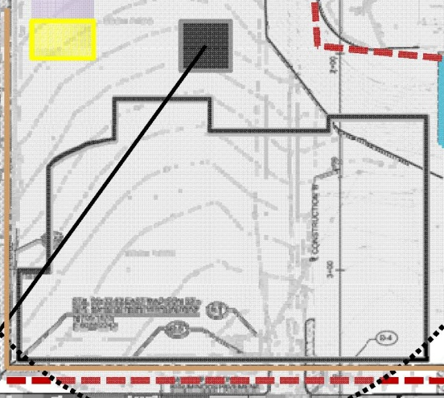
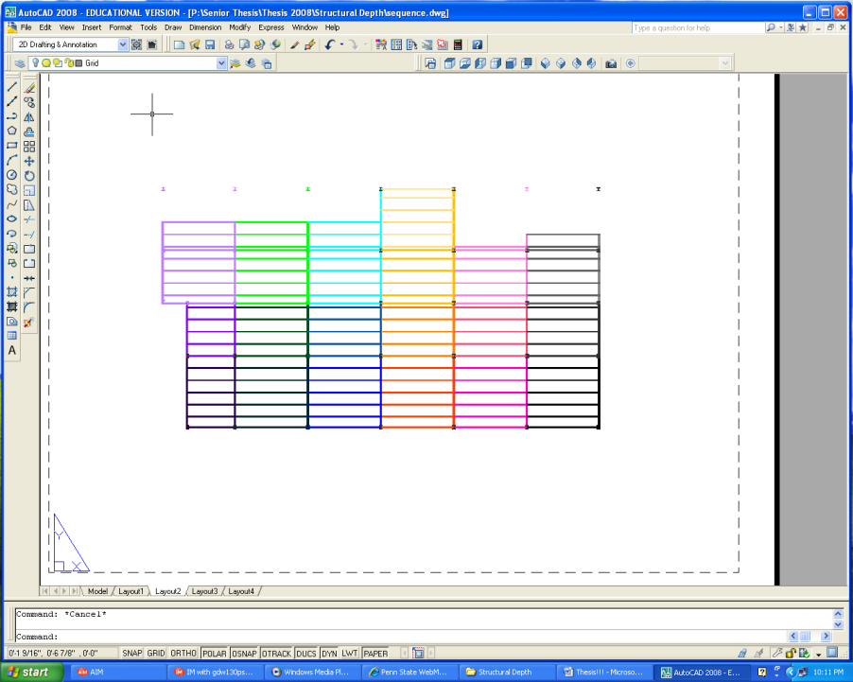
Kennedy Krieger Institute
Outpatient Medical Center
Baltimore, Maryland
Katie Sennett
Construction Management
Analysis 1
Construction Sequence Schedule: Showing only the 1st floor up to the 2nd floor.
Changing Structural System
Problem: Structural System was timely and required employees to work weekends for 2 months. It was also had a high price.
Objective: To change structural system from Cast –In-Place Concrete to Structural Steel to reduce construction schedule and project cost.
Procedure
  Redesign structural system
  Determine NEW construction schedule
  Create Sequence schedule
  Cost comparison to original system
Section Schedule | 25-Jun | 26-Jun | 27-Jun | 28-Jun | 29-Jun | 2-Jul | 3-Jul | 4-Jul | 5-Jul
Section 1-1 | Steel erection | Metal Deck | Concrete
Section 1-2 |  | Steel erection | Metal Deck | Concrete
Section 1-3 |  |  | Steel erection | Metal Deck | Concrete
Section 1-4 |  |  |  | Steel erection | Metal Deck | Concrete
Section 1-5 |  |  |  |  | Steel erection | Metal Deck | Concrete
Section 1-6 |  |  |  |  |  | Steel erection | Metal Deck | Concrete
Section 2-1 |  |  |  |  |  |  | Steel erection | Metal Deck | Concrete
Improving Cost, Constructability, & Quality
Project Overview
Analysis 1: Structural System
Analysis 2: Mechanical System
Analysis 3: 3D Design Coordination
Acknowledgements
Questions/Comments
End Here
N
Start Here

Slide 13
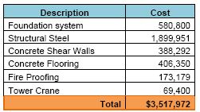
Kennedy Krieger Institute
Outpatient Medical Center
Baltimore, Maryland
Katie Sennett
Construction Management
Analysis 1
Changing Structural System
Problem: Structural System was timely and required employees to work weekends for 2 months. It was also had a high price.
Objective: To change structural system from Cast –In-Place Concrete to Structural Steel to reduce construction schedule and project cost.
Procedure
  Redesign structural system
  Determine NEW construction schedule
  Create Sequence schedule
  Cost comparison to original system
Improving Cost, Constructability, & Quality
Project Overview
Analysis 1: Structural System
Analysis 2: Mechanical System
Analysis 3: 3D Design Coordination
Acknowledgements
Questions/Comments

Slide 14
Kennedy Krieger Institute
Outpatient Medical Center
Baltimore, Maryland
Katie Sennett
Construction Management
Analysis 1
Changing Structural System
Problem: Structural System was timely and required employees to work weekends for 2 months. It was also had a high price.
Objective: To change structural system from Cast –In-Place Concrete to Structural Steel to reduce construction schedule and project cost.
Procedure
  Redesign structural system
  Determine NEW construction schedule
  Create Sequence schedule
  Cost comparison to original system
Improving Cost, Constructability, & Quality
Project Overview
Analysis 1: Structural System
Analysis 2: Mechanical System
Analysis 3: 3D Design Coordination
Acknowledgements
Questions/Comments
Cost Comparison
Cast in Place Concrete = $4,181,700
Redesigned Structural System = $3,517, 972
A TOTAL SAVINGS OF = $663,738

Slide 15
Kennedy Krieger Institute
Outpatient Medical Center
Baltimore, Maryland
Katie Sennett
Construction Management
Analysis 1
Changing Structural System
Problem: Structural System was timely and required employees to work weekends for 2 months. It was also had a high price.
Objective: To change structural system from Cast –In-Place Concrete to Structural Steel to reduce construction schedule and project cost.
Procedure
  Redesign structural system
  Determine NEW construction schedule
  Create Sequence schedule
  Cost comparison to original system
Recommendations
Benefit s the Owner by using a steel structural system by:
  Reduces the project schedule and gets the owner into the building two months sooner which allows them to start making a revenue sooner.
  Reduces overall project cost which allows owner to purchase more specialized equipment for the children.
Improving Cost, Constructability, & Quality
Project Overview
Analysis 1: Structural System
Analysis 2: Mechanical System
Analysis 3: 3D Design Coordination
Acknowledgements
Questions/Comments

Slide 16
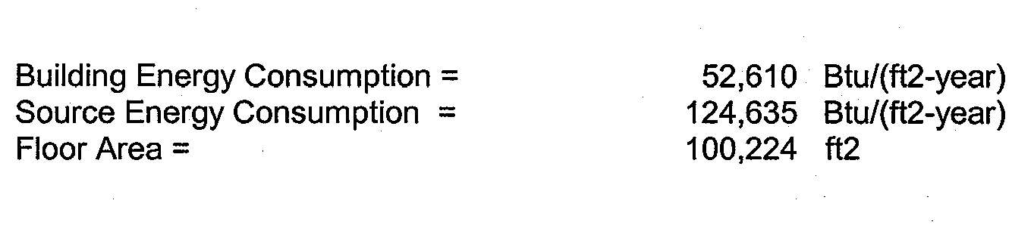
Kennedy Krieger Institute
Outpatient Medical Center
Baltimore, Maryland
Katie Sennett
Construction Management
Analysis 2
Heat Recovery System
Problem: Since the building is a medical center, it requires 100% exhaust air. This increases energy costs to heat/cool supply air.
Objective: To decrease energy costs by installing enthalpy wheels into the 3 AHU and maintain indoor air quality.
Initial Mechanical System
Includes 3 Air Handling Units with a 40,000cfm Capacity
Cooling Capacity : 246.9 Tons
: 2,962.2 Mbh
Heating Capacity : -2,270.4 Mbh
Energy Consumption
Improving Cost, Constructability, & Quality
Project Overview
Analysis 1: Structural System
Analysis 2: Mechanical System
Analysis 3: 3D Design Coordination
Acknowledgements
Questions/Comments

Slide 17
Kennedy Krieger Institute
Outpatient Medical Center
Baltimore, Maryland
Katie Sennett
Construction Management
Analysis 2
Heat Recovery System
Problem: Since the building is a medical center, it requires 100% exhaust air. This increases energy costs to heat/cool supply air.
Objective: To decrease energy costs by installing enthalpy wheels into the 3 AHU and maintain indoor air quality.
Procedure
  Evaluate Mechanical system with a heat recovery system
  Re-design air handling unit
  Cost of system
  Cost comparison to original system
Improving Cost, Constructability, & Quality
Project Overview
Analysis 1: Structural System
Analysis 2: Mechanical System
Analysis 3: 3D Design Coordination
Acknowledgements
Questions/Comments

Slide 18
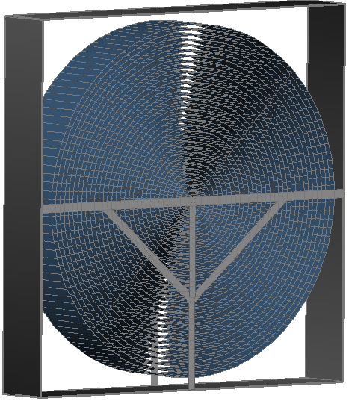
Kennedy Krieger Institute
Outpatient Medical Center
Baltimore, Maryland
Katie Sennett
Construction Management
Analysis 2
Heat Recovery System
Problem: Since the building is a medical center, it requires 100% exhaust air. This increases energy costs to heat/cool supply air.
Objective: To decrease energy costs by installing enthalpy wheels into the 3 AHU and maintain indoor air quality.
Procedure
  Evaluate Mechanical system with a heat recovery system
  Re-design air handling unit
  Cost of system
  Cost comparison to original system
The best heat recovery system for this building is the enthalpy wheel. It preconditions the air before final heating/cooling the supply air.
Improving Cost, Constructability, & Quality
Project Overview
Analysis 1: Structural System
Analysis 2: Mechanical System
Analysis 3: 3D Design Coordination
Acknowledgements
Questions/Comments
Enthalpy Wheel:
  Captures the hot/cold element from the exhaust air to pre condition the supply air.
  It prevent contaminates by expelling contaminates out through exhaust air duct.

Slide 19
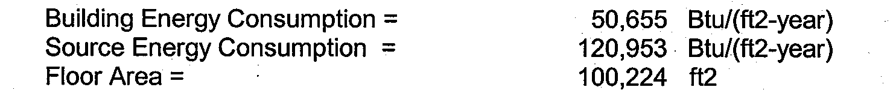
Kennedy Krieger Institute
Outpatient Medical Center
Baltimore, Maryland
Katie Sennett
Construction Management
Analysis 2
Heat Recovery System
Problem: Since the building is a medical center, it requires 100% exhaust air. This increases energy costs to heat/cool supply air.
Objective: To decrease energy costs by installing enthalpy wheels into the 3 AHU and maintain indoor air quality.
Procedure
  Evaluate Mechanical system with a heat recovery system
  Re-design air handling unit
  Cost of system
  Cost comparison to original system
Mechanical System with Enthalpy Wheels
Includes 3 Air Handling Units with a 40,000cfm Capacity
Cooling Capacity :216.6Tons
: 2,559.9 Mbh
Heating Capacity : -1,974.7 Mbh
Energy Consumption
Improving Cost, Constructability, & Quality
Project Overview
Analysis 1: Structural System
Analysis 2: Mechanical System
Analysis 3: 3D Design Coordination
Acknowledgements
Questions/Comments

Slide 20
Kennedy Krieger Institute
Outpatient Medical Center
Baltimore, Maryland
Katie Sennett
Construction Management
Analysis 2
Heat Recovery System
Problem: Since the building is a medical center, it requires 100% exhaust air. This increases energy costs to heat/cool supply air.
Objective: To decrease energy costs by installing enthalpy wheels into the 3 AHU and maintain indoor air quality.
Procedure
  Evaluate Mechanical system with a heat recovery system
  Re-design air handling unit
  Cost of system
  Cost comparison to original system
Mechanical System with Enthalpy Wheels
Cooling Capacity Difference = 30 Tons
            =400 Mbh
Heating Capacity Difference = 300 Mbh
Energy Consumption
Building Energy Consumption = 1,955 Btu/ft^2-year
Improving Cost, Constructability, & Quality
Project Overview
Analysis 1: Structural System
Analysis 2: Mechanical System
Analysis 3: 3D Design Coordination
Acknowledgements
Questions/Comments

Slide 21
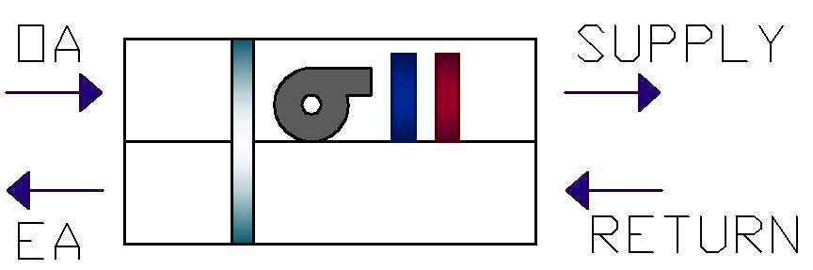
Kennedy Krieger Institute
Outpatient Medical Center
Baltimore, Maryland
Katie Sennett
Construction Management
Analysis 2
Enthalpy Wheel
Heat Recovery System
Problem: Since the building is a medical center, it requires 100% exhaust air. This increases energy costs to heat/cool supply air.
Objective: To decrease energy costs by installing enthalpy wheels into the 3 AHU and maintain indoor air quality.
Procedure
  Evaluate Mechanical system with a heat recovery system
  Re-design air handling unit
  Cost of system
  Cost comparison to original system
Improving Cost, Constructability, & Quality
Project Overview
Analysis 1: Structural System
Analysis 2: Mechanical System
Analysis 3: 3D Design Coordination
Acknowledgements
Questions/Comments

Slide 22
Kennedy Krieger Institute
Outpatient Medical Center
Baltimore, Maryland
Katie Sennett
Construction Management
Analysis 2
Heat Recovery System
Problem: Since the building is a medical center, it requires 100% exhaust air. This increases energy costs to heat/cool supply air.
Objective: To decrease energy costs by installing enthalpy wheels into the 3 AHU and maintain indoor air quality.
Procedure
  Evaluate Mechanical system with a heat recovery system
  Re-design air handling unit
  Cost of system
  Cost comparison to original system
Cost of System
Each Enthalpy wheel costs = $39,550
The new system needs 3 (one for each AHU)
Total = $118,650
Improving Cost, Constructability, & Quality
Project Overview
Analysis 1: Structural System
Analysis 2: Mechanical System
Analysis 3: 3D Design Coordination
Acknowledgements
Questions/Comments

Slide 23

Kennedy Krieger Institute
Outpatient Medical Center
Baltimore, Maryland
Katie Sennett
Construction Management
Analysis 2
Heat Recovery System
Problem: Since the building is a medical center, it requires 100% exhaust air. This increases energy costs to heat/cool supply air.
Objective: To decrease energy costs by installing enthalpy wheels into the 3 AHU and maintain indoor air quality.
Procedure
  Evaluate Mechanical system with a heat recovery system
  Re-design air handling unit
  Cost of system
  Cost comparison to original system
Cost Comparison to Original System
Improving Cost, Constructability, & Quality
Project Overview
Analysis 1: Structural System
Analysis 2: Mechanical System
Analysis 3: 3D Design Coordination
Acknowledgements
Questions/Comments

Slide 24
Kennedy Krieger Institute
Outpatient Medical Center
Baltimore, Maryland
Katie Sennett
Construction Management
Analysis 2
Recommendations
The Enthalpy wheel was found to save about $3,000 per year on energy costs. However, the total cost of the wheels is $118,650 and it would take 41 years to pay off the wheels before saving money on energy consumption.
The wheels are also very large and need a long lead time prior to installation.
The buildings roof is also not designed to be remove to maintain and replace the systems which are located in the penthouse.
Saving energy is good but in this case it is just to costly for the owner.
Heat Recovery System
Problem: Since the building is a medical center, it requires 100% exhaust air. This increases energy costs to heat/cool supply air.
Objective: To decrease energy costs by installing enthalpy wheels into the 3 AHU and maintain indoor air quality.
Procedure
  Evaluate Mechanical system with a heat recovery system
  Re-design air handling unit
  Cost of system
  Cost comparison to original system
Improving Cost, Constructability, & Quality
Project Overview
Analysis 1: Structural System
Analysis 2: Mechanical System
Analysis 3: 3D Design Coordination
Acknowledgements
Questions/Comments

Slide 25
Kennedy Krieger Institute
Outpatient Medical Center
Baltimore, Maryland
Katie Sennett
Construction Management
Analysis 3 - Critical Industry Research
3D Design Coordination
Problem: This project did not use 3D design coordination for the MEP system. This created many unproductive meetings and many changes orders.
Objective: To research the use of 3D design coordination for MEP systems with clash detection and to figure out companies think about it.
Improving Cost, Constructability, & Quality
Project Overview
Analysis 1: Structural System
Analysis 2: Mechanical System
Analysis 3: 3D Design Coordination
Acknowledgements
Questions/Comments

Slide 26
Kennedy Krieger Institute
Outpatient Medical Center
Baltimore, Maryland
Katie Sennett
Construction Management
Analysis 3 - Critical Industry Research
3D Design Coordination
Problem: This project did not use 3D design coordination for the MEP system. This created many unproductive meetings and many changes orders.
Objective: To research the use of 3D design coordination for MEP systems with clash detection and to figure out companies think about it.
Procedure
Figure out the cost of the program
Survey results
Conclusion
Improving Cost, Constructability, & Quality
Project Overview
Analysis 1: Structural System
Analysis 2: Mechanical System
Analysis 3: 3D Design Coordination
Acknowledgements
Questions/Comments

Slide 27
Kennedy Krieger Institute
Outpatient Medical Center
Baltimore, Maryland
Katie Sennett
Construction Management
Analysis 3 - Critical Industry Research
3D Design Coordination
Problem: Many unproductive MEP coordination meetings which resulted in many changes orders.
Objective: To research the use of 3D design coordination for MEP systems with clash detection and to survey the contractors and designs on the project about their thoughts on the program
Procedure
Figure out the cost of the system
Survey results
Conclusion
The cost of the system
3D design coordination requires computer software and training.
Improving Cost, Constructability, & Quality
Project Overview
Analysis 1: Structural System
Analysis 2: Mechanical System
Analysis 3: 3D Design Coordination
Acknowledgements
Questions/Comments
 |  |  | Autodesk
Software | Price |  | Corporate Classroom Training
AutoCAD | $3,970 |  | 3-Day (27hrs) = $2,350
Revit MEP | $2,536 |  | 5-Day (45hrs) = $3,950
Revit Structural | $3,103 |  | Corporate On-Site Training
NavisWorks | $8,000 |  | 3-Day (27hrs) = $1,950
 |  |  | 5-Day (45hrs) = $3,250

Slide 28
Kennedy Krieger Institute
Outpatient Medical Center
Baltimore, Maryland
Katie Sennett
Construction Management
Analysis 3 - Critical Industry Research
3D Design Coordination
Problem: Many unproductive MEP coordination meetings which resulted in many changes orders.
Objective: To research the use of 3D design coordination for MEP systems with clash detection and to survey the contractors and designs on the project about their thoughts on the program
Procedure
Figure out the cost of the system
Survey results
Conclusion
Survey Results
Companies lack the resources and the funds
Coordinating project team is very difficult
Most larger companies are subcontracting the 3D design work out to specialists
Improving Cost, Constructability, & Quality
Project Overview
Analysis 1: Structural System
Analysis 2: Mechanical System
Analysis 3: 3D Design Coordination
Acknowledgements
Questions/Comments

Slide 29
Kennedy Krieger Institute
Outpatient Medical Center
Baltimore, Maryland
Katie Sennett
Construction Management
Analysis 3 - Critical Industry Research
3D Design Coordination
Problem: Many unproductive MEP coordination meetings which resulted in many changes orders.
Objective: To research the use of 3D design coordination for MEP systems with clash detection and to survey the contractors and designs on the project about their thoughts on the program
Procedure
Figure out the cost of the system
Survey results
Conclusion
Conclusion
Companies are aware the price to implement the program
Companies know the process to utilize
Companies feel that once technology increases more and the demand to use 3D design coordination increases, companies will then start implementing and utilizing 3D design coordination on construction projects.
Improving Cost, Constructability, & Quality
Project Overview
Analysis 1: Structural System
Analysis 2: Mechanical System
Analysis 3: 3D Design Coordination
Acknowledgements
Questions/Comments

Slide 30
Kennedy Krieger Institute
Outpatient Medical Center
Baltimore, Maryland
Katie Sennett
Construction Management
Acknowledgements
I would like to thank:
Kennedy Krieger Institute
Project Team @ Whiting-Turner Contracting
AE Faculty and Staff
Family and Friends
Thank You
Improving Cost, Constructability, & Quality
Project Overview
Analysis 1: Structural System
Analysis 2: Mechanical System
Analysis 3: 3D Design Coordination
Acknowledgements
Questions/Comments

Slide 31

Kennedy Krieger Institute
Outpatient Medical Center
Baltimore, Maryland
Katie Sennett
Construction Management
Questions / Comments
?
Improving Cost, Constructability, & Quality
Project Overview
Analysis 1: Structural System
Analysis 2: Mechanical System
Analysis 3: 3D Design Coordination
Acknowledgements
Questions/Comments

Slide 32
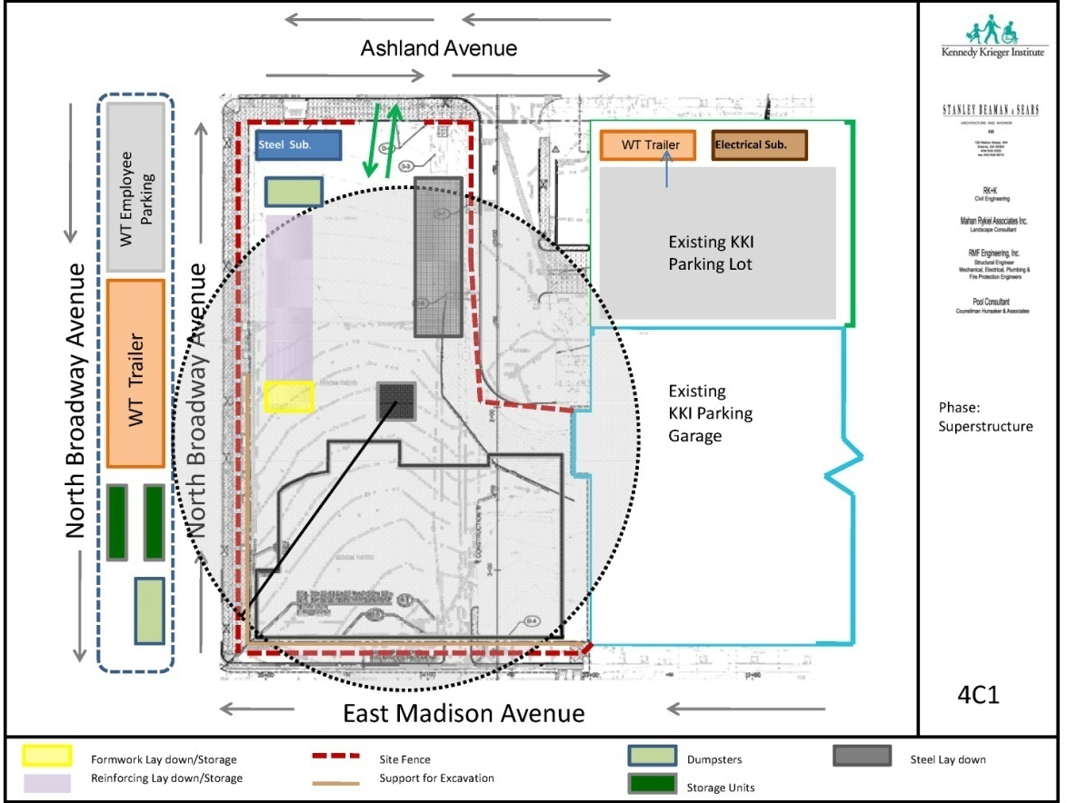
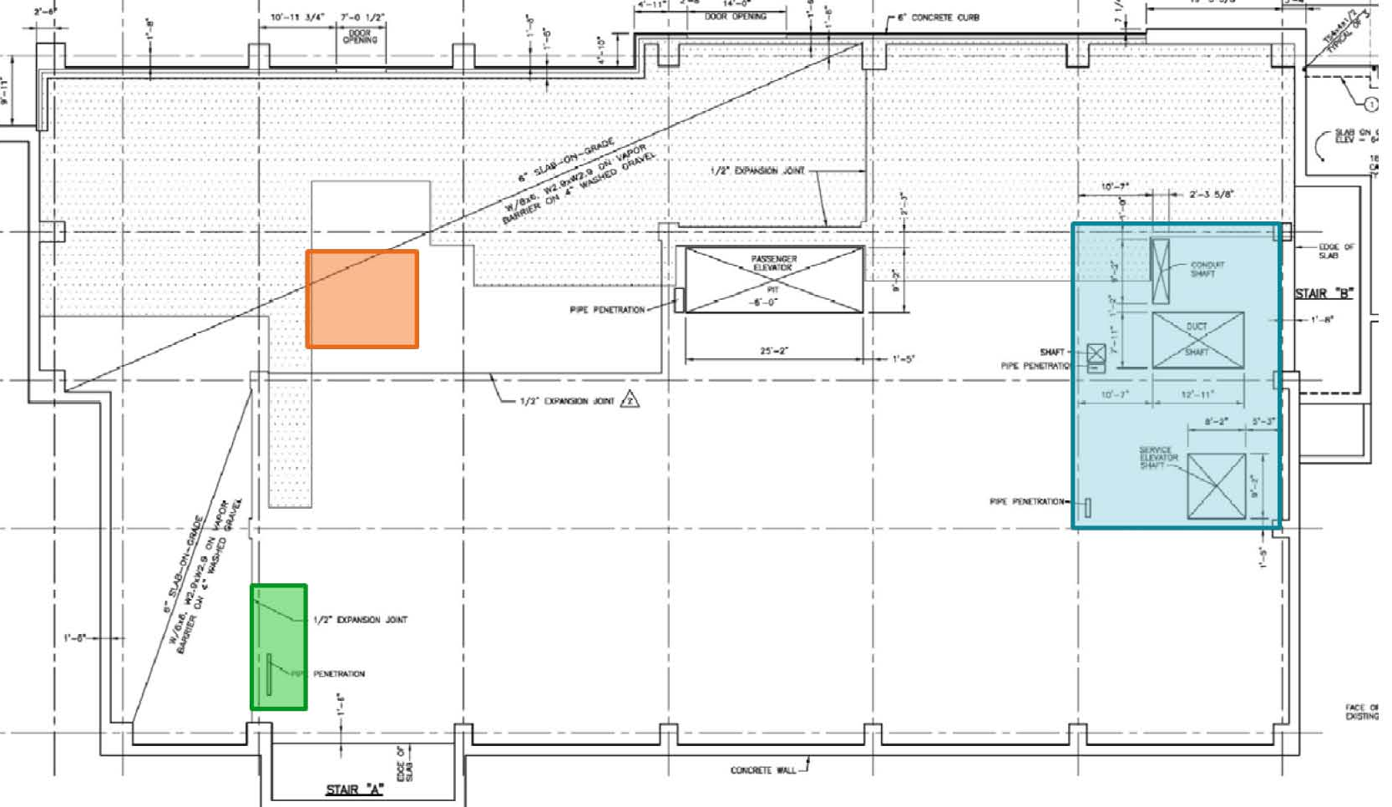
Kennedy Krieger Institute
Outpatient Medical Center
Baltimore, Maryland
Katie Sennett
Construction Management
Site Plan & Penetration
Improving Cost, Constructability, & Quality
Project Overview
Analysis 1: Structural System
Analysis 2: Mechanical System
Analysis 3: 3D Design Coordination
Acknowledgements
Questions/Comments

Slide 33
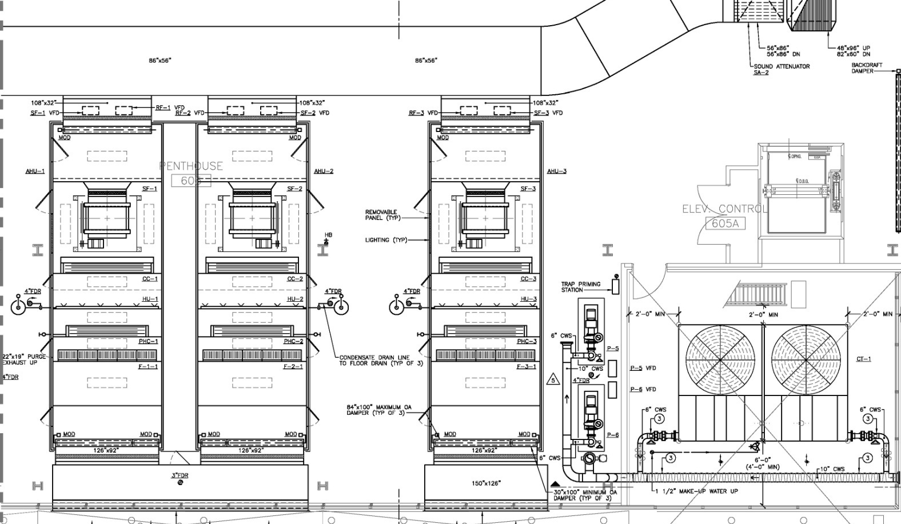
Kennedy Krieger Institute
Outpatient Medical Center
Baltimore, Maryland
Katie Sennett
Construction Management
Mechanical
Improving Cost, Constructability, & Quality
Project Overview
Analysis 1: Structural System
Analysis 2: Mechanical System
Analysis 3: 3D Design Coordination
Acknowledgements
Questions/Comments

Slide 34
Kennedy Krieger Institute
Outpatient Medical Center
Baltimore, Maryland
Katie Sennett
Construction Management
Interview Sources
Improving Cost, Constructability, & Quality
Project Overview
Analysis 1: Structural System
Analysis 2: Mechanical System
Analysis 3: 3D Design Coordination
Acknowledgements
Questions/Comments
Interview Sources
Name | Company | Role
Fred Nash | Enterprise Electric | CAD Operator
Louis Westermeyer | Windsor Electirc Co. | Project Manager
Thomas Fidler | Brown & Heim Electric Contractors | Vice President
Graham Erbe | Southern Mechanical | Estimator/Project Manager
N/A | Mechanical Engineering & Construction Corporation | Project Manager

